Slide 1
BITS Pilani
Dr. Lavika Goel
Assistant Professor
Department of CSIS
Pilani Campus

Slide 2
Pilani Campus
Subprograms

Slide 3
Agenda
Subprogram parameters
Design issues
Semantic models of parameter passing
Parameter passing methods:
Call by value
Call by result
Call by reference
Call by value result
Call by name
Pilani Campus

Slide 4
Subprogram
Fundamental building blocks of programs, collection of statements that can be reused.
Characteristics:
Each subprogram has a single entry point.
The calling program unit is suspended during the execution of the called subprogram, which implies that there is only one subprogram in execution at any given time.
Control always returns to the caller when the subprogram execution terminates.
Pilani Campus

Slide 5
Subprogram parameters
Parameters in a subprogram are called as formal parameters. They are dummy variables (or placeholders for actual parameters to be supplied in a function call) and they are bound to storage only when the subprogram is called and that binding is often through other program variables.
Subprogram call statements must include the name of the subprogram and a list of parameters to be bound to the formal parameters of the subprogram. These parameters are called as actual parameters.
Pilani Campus

Slide 6
Design issues for subprograms
Are local variables statically or dynamically allocated?
Can subprogram definitions appear in other subprogram definitions?
What parameter passing methods are used?
Are the types of the actual parameters checked against the types of the formal parameters?
If subprograms can be passed as parameter?
Can subprograms be overloaded?
Pilani Campus

Slide 7
Parameter passing methods
Ways in which parameters are transmitted to and from the called subprograms.
Semantics models of parameter passing:
Formal parameters can receive the data from the corresponding actual parameter. (in mode)
They can transmit the data to the actual parameter. (out mode)
Or they can do both. (in-out mode)
Pilani Campus

Slide 8
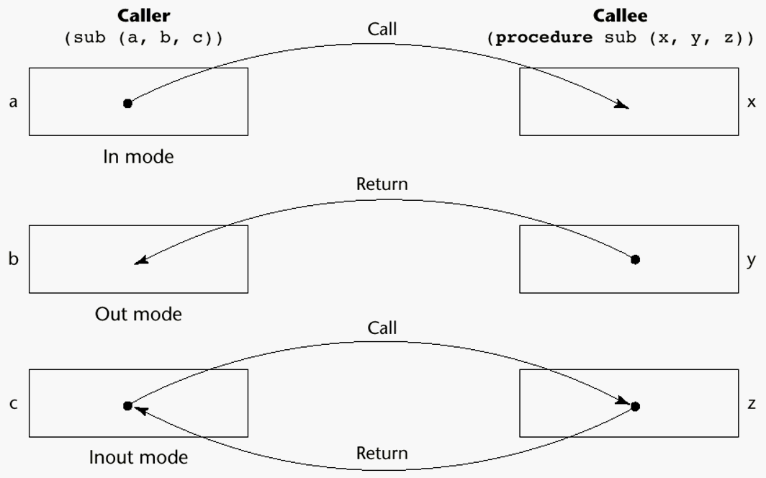
Models of Parameter Passing
Pilani Campus

Slide 9
Example
Consider a subprogram that takes 2 int arrays as parameters, list1 and list2. The subprogram must add list1 to list2 and return the result as a revised version of list2. The subprogram must create a new array from the 2 given arrays and return it.
list1 – in mode
list2 – in-out mode
list3 –out mode
Pilani Campus

Slide 10
Implementation models of parameter passing
Physically move a value
Move an access path to a value
Pilani Campus

Slide 11
Pass-by-Value (In Mode)
The value of the actual parameter is passed to the corresponding formal parameter. Formal parameter is a local variable to the function.
  Normally implemented by copying
  Disadvantages (if by physical move): additional storage is required (stored twice) and the actual move can be costly (for large parameters), formal parameters will be stored as local variables in the stack of the function.
Pilani Campus

Slide 12
Example of pass by value
void swap1(int a, int b)
{
int temp=a;
a=b;
b=temp;
}
swap1(c,d);
Pass by value:
a=c;
b=d;
temp=a;
a=b;
b=temp;
a has d’s value and b has c’s value but changes are not passed back to the calling function so values of c and d are unchanged.
Pilani Campus

Slide 13
Pass-by-Result (Out Mode)
When a parameter is passed by result, no value is transmitted to the subprogram; the corresponding formal parameter acts as a local variable; its value is transmitted to caller’s actual parameter when control is returned to the caller, by physical move
  Require extra storage location and copy operation
Pilani Campus

Slide 14
Pass-by-result
There can be an actual parameter collision but the formal parameters can have different names and therefore they can have different values.
In this case, whichever of the two is copied to the actual parameter in the last, that becomes the value of the actual parameter ‘a’.
Void Fixer(int x, int y)
{
x= 17;
y= 35;
}
Consider the call:
Fixer(a,a);
The order in which the actual parameters are copied determines their value
  Left to right
  Right to left
Output:
Value of a= 35 (if x is assigned to actual parameter first i.e. left to right)
Output:
Value of a= 17 (if y is assigned to actual parameter first i.e. right to left)
Pilani Campus

Slide 15
Pass-by-result
Binding of the address of the actual parameter can be done at the time of the call or at the time of the return.
The address of list[sub] changes between the beginning and end of the method.
Void doit(int x, int index)
{
x=17;
index=42;
}
Consider the call:
sub=21;
doit(list[sub],sub);
Binding of actual parameter to an address:
  At the time of the call:
  FP1=x FP2= index
  AP1=list[21] AP2=sub
  Output:
  List[21]=17 and sub=42
  FP: Formal parameter
  AP: Actual parameter
Pilani Campus

Slide 16
Pass-by-result
Void doit(int x, int index)
{
x=17;
index=42;
}
Consider the call:
sub=21;
doit(list[sub],sub);
  At the end of the call:
  FP1=x FP2= index
  AP1=list[42] (in case of right-to-left) and list[21] (in case of left-to-right)
  AP2=sub
  Output:
  List[42]=17 and sub=42(in case of Right-left)
  List[21]=17 and sub=42(in case of left-right)
Pilani Campus

Slide 17
Pass-by-Value-Result (inout Mode)
A combination of pass-by-value and pass-by-result: Actual values are copied to formal parameters which then acts as local variables in the called subprogram. At program termination, the value of the formal parameter is copied back to the actual parameter.
Sometimes called pass-by-copy
  Disadvantage: Require extra storage location and copy operation
Pilani Campus

Slide 18
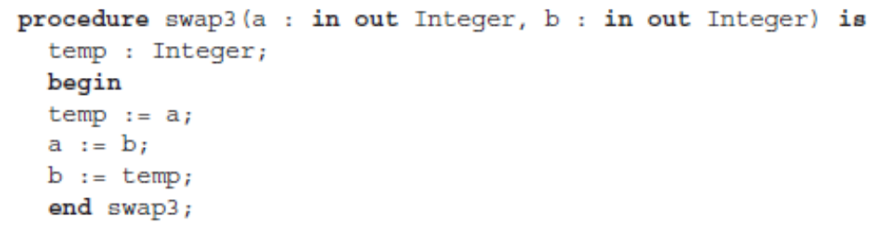

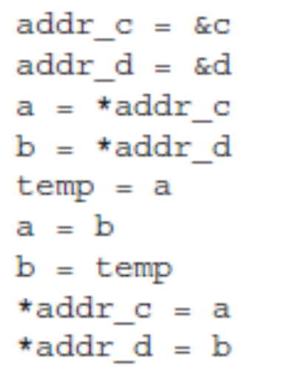
Pass by value result (Ada example)
Pilani Campus

Slide 19
Pass-by-Reference (Inout Mode)
Formal parameters store the location of actual parameter. In this method, an access path is passed to the called subprogram (location)
Advantage: Passing process is efficient (no copying and no duplicated storage)
Disadvantages
  Slower accesses (compared to pass-by-value) to formal parameters because indirect addressing
  If one-way communication is required to the called subprogram, then erroneous changes might occur in the actual parameters.
  Unwanted aliases (access broadened): Access path is available to the called subprograms thus providing access to non-local variables. Examples:
  void fun (int &first, int &second) , fun(total, total)
  int *global;
  void main () {
  sub(global);
  }
  void sub(int *param)
  { …}
Pilani Campus

Slide 20
Pass by reference
void swap2(int *a, int *b)
{
int temp=*a;
*a=*b;
*b=temp;
}
swap2(&c, &d);
Pass by reference:
a=&c;
b=&d;
temp=*a;
*a=*b;
*b=temp;
c and d values are interchanged.
Pilani Campus

Slide 21
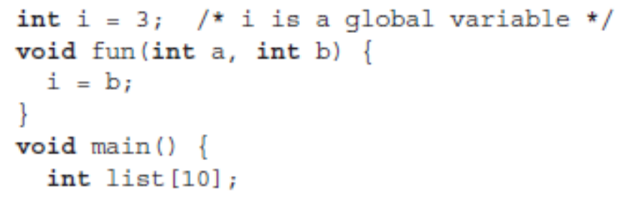
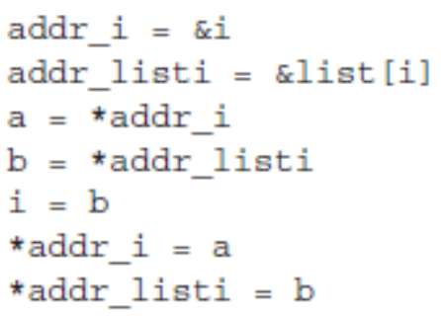
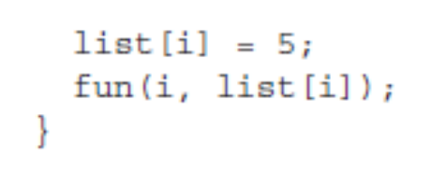
Example
If pass by value result is used, i = 3
If pass by reference is used, i = 5
Pilani Campus

Slide 22
Pass-by-name
Pass-by-name is inout-mode parameter transmission method.
In this, actual parameter textually substitutes the formal paramaeter.
Effect of the Call swap(x,y)
temp = x;
x =y;
y = temp;
Output:
x=7
y=5
Procedure swap(a,b)
int a,b,temp;
Begin
temp = a;
a = b;
b = temp;
End;
x=5,y=7;
swap(x,y);
Pilani Campus

Slide 23
Implementing Parameter-Passing Methods
In most languages parameter communication takes place through the run-time stack
Pass-by-reference are the simplest to implement; only an address is placed in the stack
Pilani Campus

Slide 24
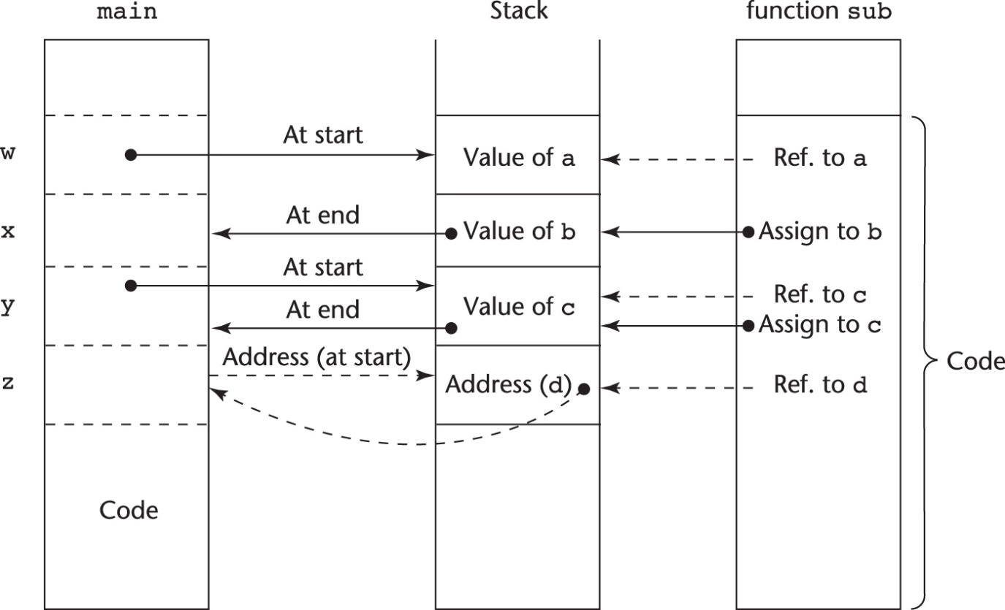
Implementing Parameter-Passing Methods
Function header: void sub(int a, int b, int c, int d)
Function call in main: sub(w, x, y, z)
(pass w by value, x by result, y by value-result, z by reference)
Pilani Campus

Slide 25
Parameter passing: Call by value
int x=1; // global x
void func1 (int a)
{
// location 2 location 2: a is 1, x is 1
x=2;
// location 3 location 3: a is 1 , x is 2
a=5;
// location 4 location 4: a is 5, x is 2
}
void main() {
// location 1 location 1: a undefined, x is 1
func1(x);
// location 5 location 5: x is 2
}
Pilani Campus

Slide 26
Parameter passing: Call by reference
int x=1; // global x
void func1 (int a)
{
// location 2 location 2: a is 1, x is 1
x=2;
// location 3 location 3: a is 2 , x is 2
a=5;
// location 4 location 4: a is 5, x is 5
}
void main() {
// location 1 location 1: a undefined, x is 1
func1(x);
// location 5 location 5: x is 5
}
Pilani Campus

Slide 27
Parameter passing: Call by value-result
int x=1; // global x
void func1 (int a)
{
// location 2 location 2: a is 1, x is 1
a=3;
// location 3 location 3: a is 3 , x is 1
x=4;
// location 4 location 4: a is 3, x is 4
}
void main() {
// location 1 location 1: a undefined, x is 1
func1(x);
// location 5 location 5: x is 3
}
Pilani Campus

Slide 28
Example
int n;
void p(int k)
{
n=n+1;
k=k+4;
printf(“%d”, n);
}
main()
{
n=0;
p(n);
printf(“%d”, n);
}
Output:
Call-by-value: 1 1
Call-by-reference: 5 5
Call-by-value-result: 1 4
Pilani Campus

Slide 29
Pass by name: Example
function (int a, int b, int c)
{
b = b + 5;
b = a + c + 4;
printf (“%d %d %d”, a, b, c);
}
main ( )
{
int j = 10;
ink k = 15;
function (j, j, j + k);
printf (“%d %d”, j, k);
}
49 49 64 49 15
Formal arguments will be textually replaced with actual arguments i.e. a will be replaced with j, b will be replaced with j and c will be replaced with (j + k)
Pilani Campus

Slide 30

Pass by name: Example
Procedure swap(a,b)
int a,b,temp;
Begin
temp = a;
a = b;
b = temp;
End;
i=2
X ={1,3,5,7,9,11}
swap(i, x[i]);
Effect of call swap(i, x[i])
temp = i;
i = x[i];
x[i] = temp;
Value of i=5
Value of x[0]=1
Value of x[1]=3
Value of x[2]=5
Value of x[3]=7
Value of x[4]=9
Value of x[5]=2
Pilani Campus

